Slide 1
gathering some decent-ish data on police shootings . . . hopefully
why is it so hard?

Slide 2

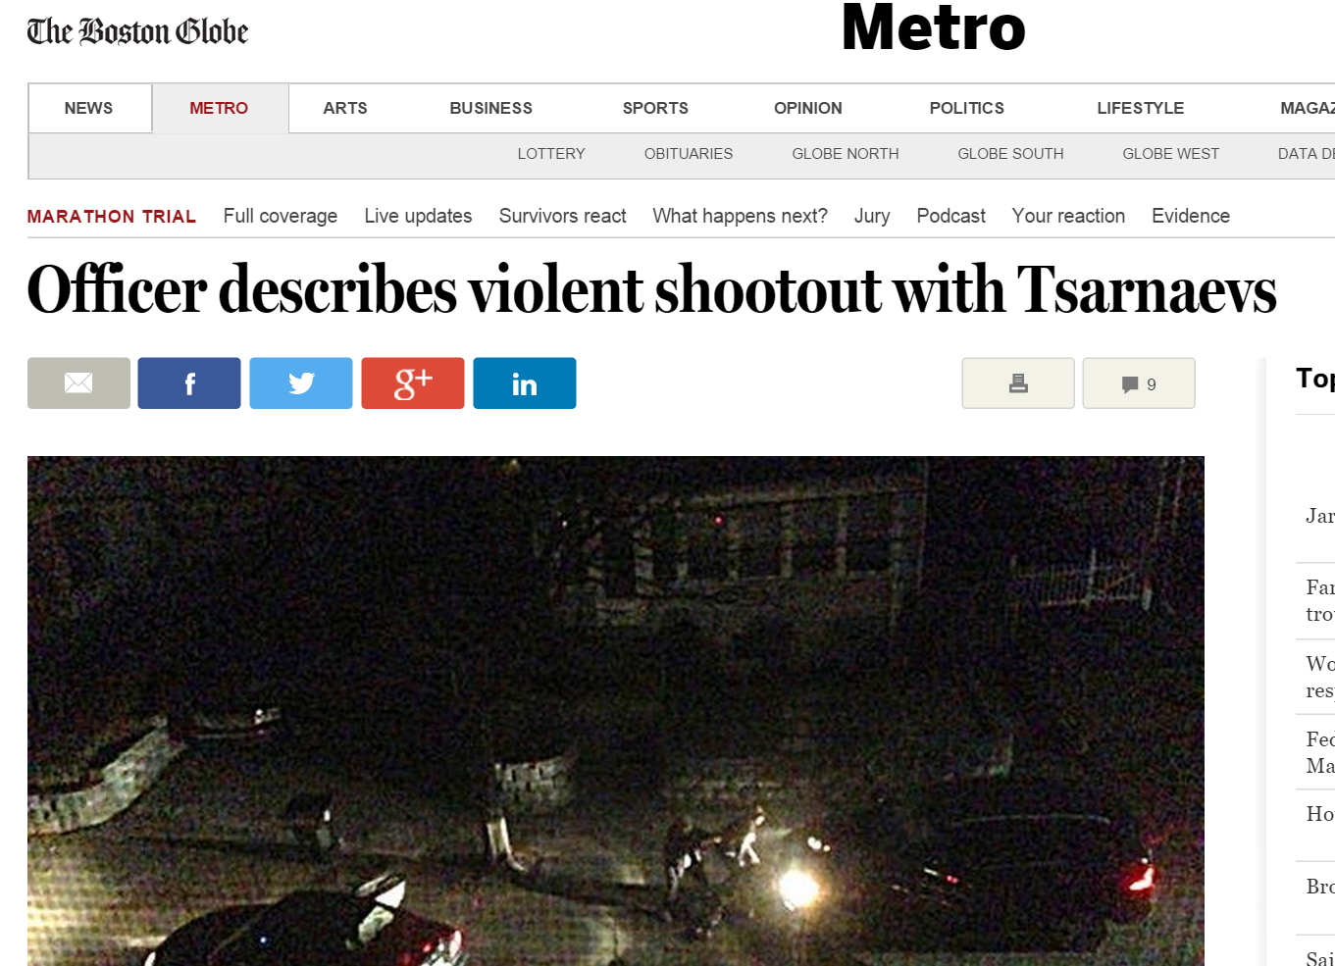
police officers shoot civilians . . . sometimes a shooting is justified, sometimes not

Slide 3
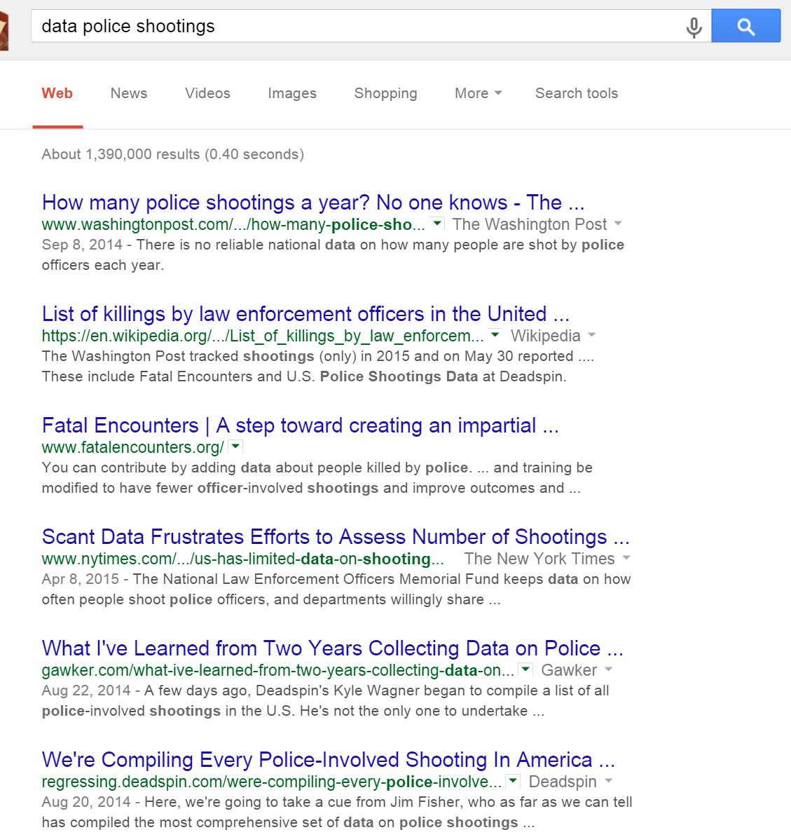
do we or could we know anything about police shootings that happen across the US?

Slide 4
some groups and individuals are attempting to gather police shootings data, but it’s messy
Fatal Encounters: http://www.fatalencounters.org/
Deadspin: http://regressing.deadspin.com/were-compiling-every-police-involved-shooting-in-americ-1624180387
Wikipedia: https://goo.gl/LWUJ3V
Washington Post: http://goo.gl/ZDUYxk
The Guardian: http://www.theguardian.com/us-news/ng-interactive/2015/jun/01/about-the-counted
None are comprehensive and there are no federal government accountability and reporting standards for local police departments

Slide 5
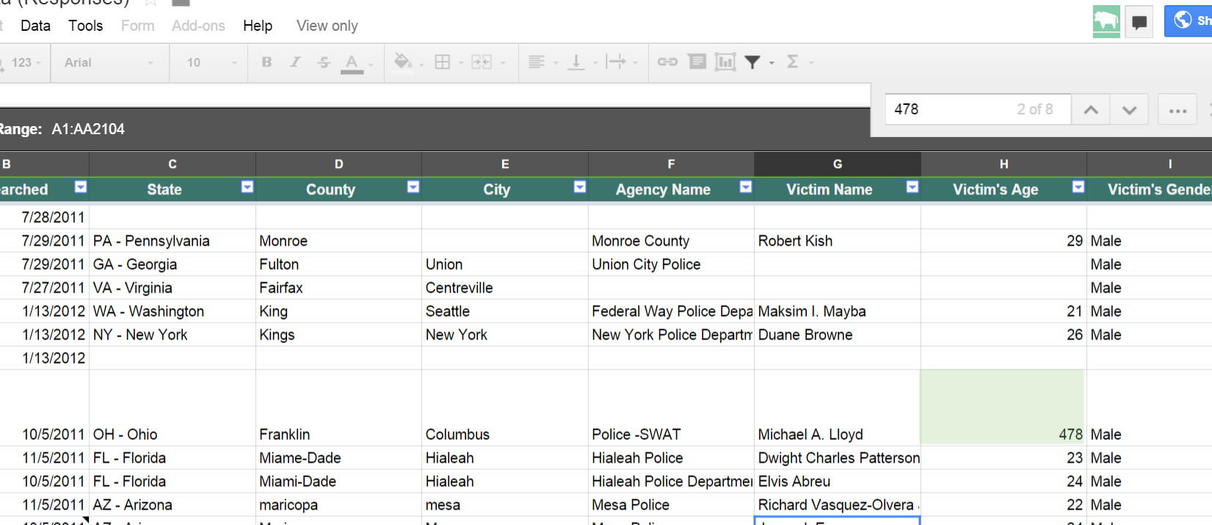
not all of the data gathered is publicly available and what is, is ugly

Slide 6
ETL to the rescue!
https://en.wikipedia.org/wiki/Extract,_transform,_load
Extract → Transfer → Load
Use pandas to read publicly available good spreadsheets in csv format
Load the raw data into sqlite database
Munge the data into a common format
Combine the munged data into a single data set
Load the combined data set into sqlite database

Slide 7
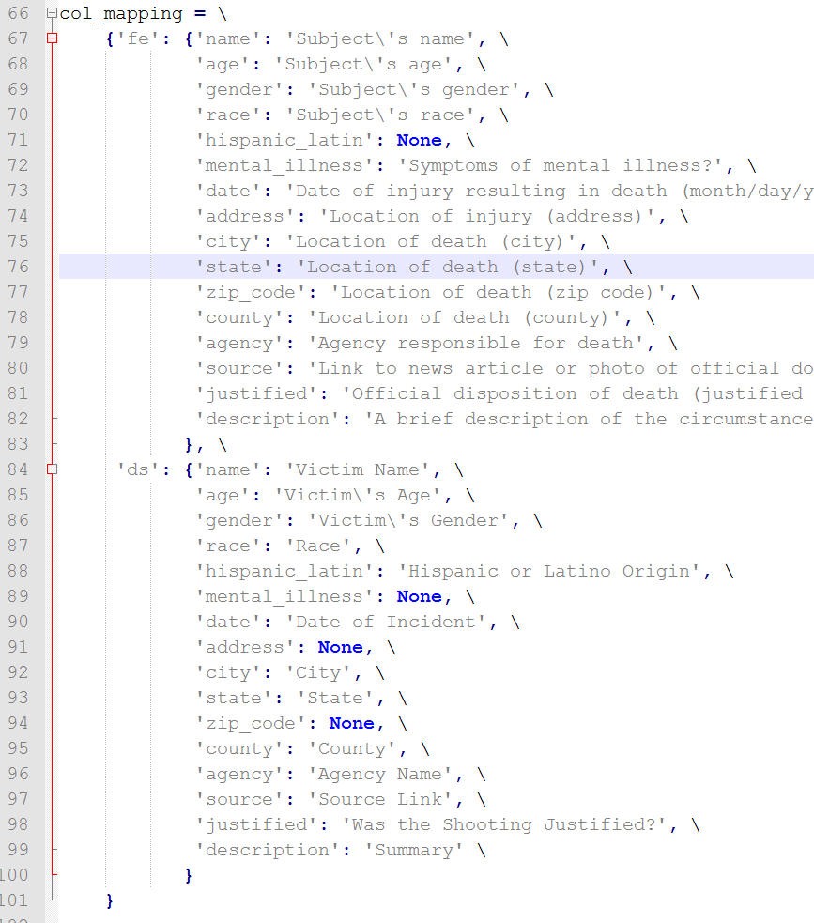
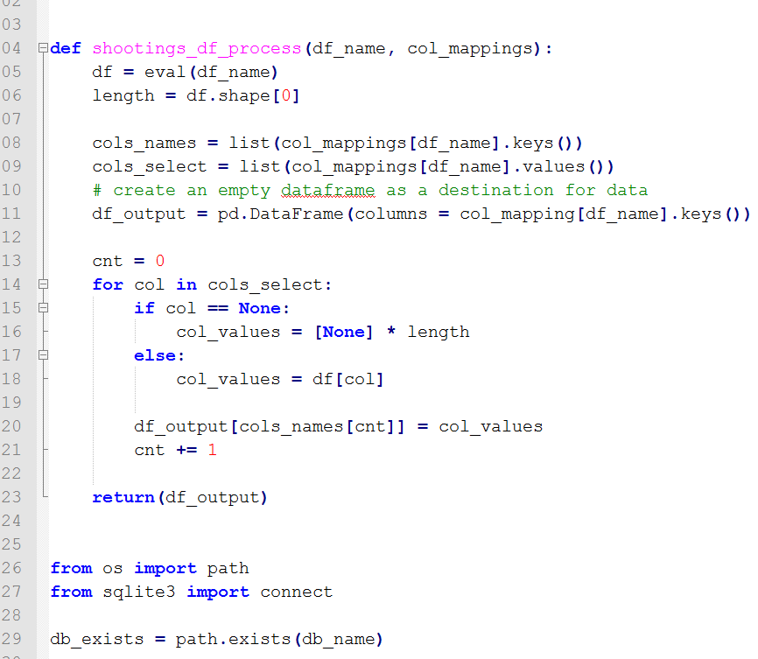
an ETL process looks like this

Slide 8
can we learn anything about the justification of shootings from the combined data set?
YES! . . . well kinda
actual
1 56
2 48
3 73
4 51
5 46
build features:
Race/ethnicity
Gender
Age
State
ratings exhibit something tending towards a normal distribution
N = ~1200 individual shootings with justification ratings

Slide 9
try logistic regression
model_lr = LogisticRegressionCV(Cs = [0.01,.1, 1, 2.5, 5, 10], cv = 100)
rf_error 1.470803
lr_error 1.259124
gbm_error 1.751825
avg_error 1.231144
Coef Features
0.841513 UT
0.792801 race_black
0.753770 VA
0.671044 MI

Slide 10
try random forest
model_rf = RandomForestClassifier(n_estimators = 20, max_depth = 1500, n_jobs = -1)
rf_error 1.401460
lr_error 1.310219
gbm_error 1.751825
avg_error 1.231144

Slide 11
try gradient boosting
model_gbm = GradientBoostingClassifier(loss = 'deviance', n_estimators = 1000, max_depth = 5)
rf_error 1.470803
lr_error 1.310219
gbm_error 1.467153
avg_error 1.231144

Slide 12
when the three algorithms are averaged predictions improve, but . . .
rf_error 1.401460 → 68 correct
lr_error 1.259124 → 71 correct
gbm_error 1.467153 → 59 correct
avg_error 1.256691 → 54 correct

Slide 13
the algorithms do a decent job of predicting the justification level of a shooting except . . .
1
rf_error 1.535714
lr_error 1.500000
gbm_error 1.553571
avg_error 1.529762
dtype: float64
2
rf_error 1.464286
lr_error 1.107143
gbm_error 1.392857
avg_error 1.095238
dtype: float64
3
rf_error 1.083333
lr_error 0.366667
gbm_error 1.250000
avg_error 0.766667
dtype: float64
4
rf_error 1.235294
lr_error 1.392157
gbm_error 1.274510
avg_error 1.065359
dtype: float64
5
rf_error 1.725490
lr_error 2.078431
gbm_error 1.901961
avg_error 1.901961
dtype: float64

Slide 14
what’s next
Much better model tuning
Much better ETL process
Clean up Python code (ie: def main())
Database table for exceptions to be reviewed
Cloud-ify
Crawl news articles using BeautifulSoup and evaluate using NLTK sentiment analysis

Slide 15
tools used / where to find
Anaconda Distribution of Python 3.4
Spyder (Python IDE)
iPython Notebook
Notepad++
Find code and this presentation on Github:
https://github.com/nateGir/policeShootings

